Slide 1
Programming Fundamentals
by Abeeha Sattar

Slide 2
Problem Solving
Define the problem
Determine the cause(s) of the problem
Develop potential solutions
Select a solution
Implement a solution
Evaluate the solution
Repeat from 1 if not satisfactory

Slide 3
Problem Analysis Chart
Given Data | Required Results
Data given in the problem or provided by the user. Can be known values or general names for data (e.g. price, quantity) | Requirements for the output reports. Contains information needed and the format it needs to be presented in.
Processing Required | Solution Alternatives
List of processing steps required. Contains equations or any other type of processing (e.g. sorting, searching) | List of ideas for the solution of the problem.

Slide 4
Flowcharts
According to a dictionary, a flowchart is:
a diagram of the sequence of movements or actions of people or things involved in a complex system or activity.
a graphical representation of a computer program in relation to its sequence of functions (as distinct from the data it processes).
The second one is more relevant for use though!

Slide 5
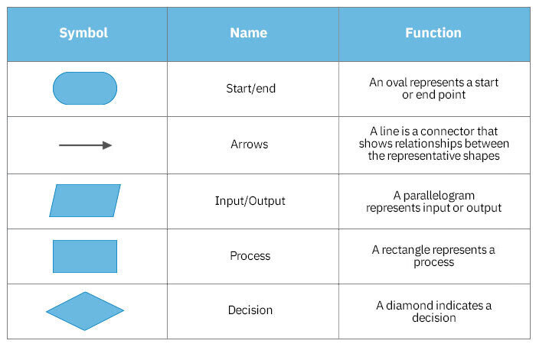
Flowchart Symbols
https://www.smartdraw.com/flowchart/flowchart-symbols.htm

Slide 6
Examples
Let’s do the flowchart for one of the algorithms we wrote yesterday

Slide 7
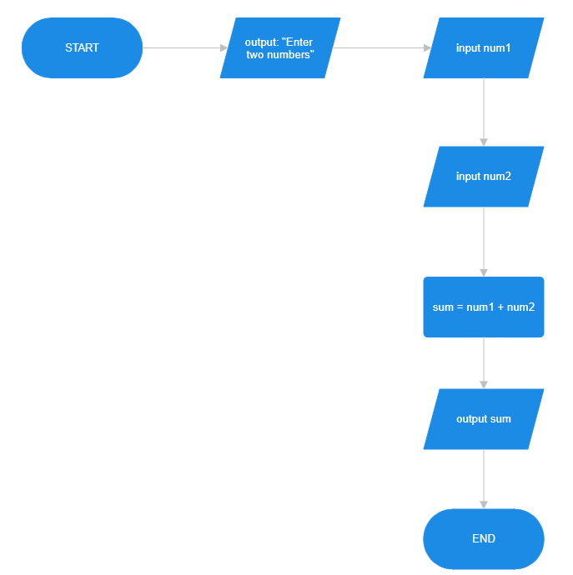

Slide 8


Let’s move to: Conditional Statements
Here’s some examples:
IF you’re happy and you know it
THEN clap your hands
ENDIF
IF you’re happy and you know it
THEN clap your hands
ELSE
make a frowny face
ENDIF
IF you’re happy and you know it
THEN clap your hands
ELSE IF you feel sad
make emoji
ELSE
make emoji
ENDIF

Slide 9
More on Conditional Statements (IF ELSE)
Indentation is important when writing pseudocode
Example:
Pet the cat
IF cat growls
Stop petting the cat
Run for dear life
Say psstpsstpsst to the cat
Go to step 1

Slide 10
Number Guessing with friends
Pick a number from 1-1000 and don’t tell your friend
Ask your friend to guess a number
IF your friend’s guess is lower than the number you selected
Ask your friend to guess a higher number
Go to step 2
ELSE IF your friend’s guess is higher than the number you selected
Ask your friend to guess a lower number
Go to step 2
ELSE
Your friend has guessed correctly, congratulate them!

Slide 11
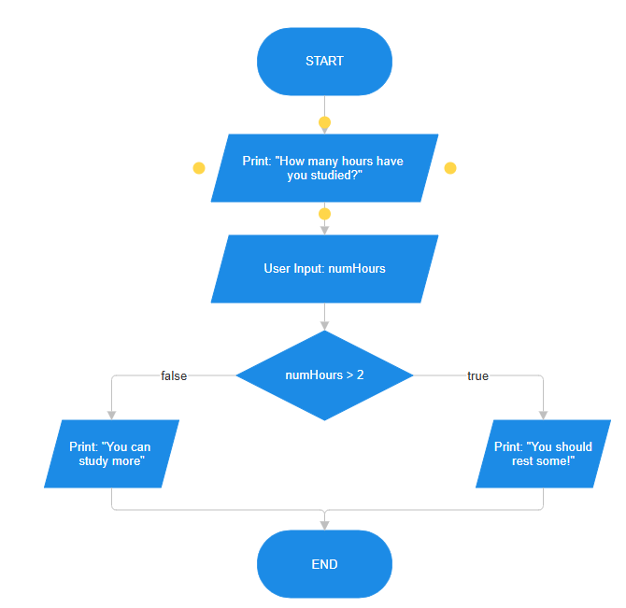
Examples of Conditions in Flowcharts

Slide 12
An Example of Nested Conditions
Pseudocode/Flowchart for finding out the maximum of 3 numbers provided by the user. Let’s try it out!

Slide 13
Iterations in pseudocode:
(We’ll stick to “REPEAT” and “UNTIL” keywords for now)
START
INIT loop_var = 0
REPEAT
PRINT loop_var
INCREMENT loop_var by 1
UNTIL loop_var = 10
END

Slide 14
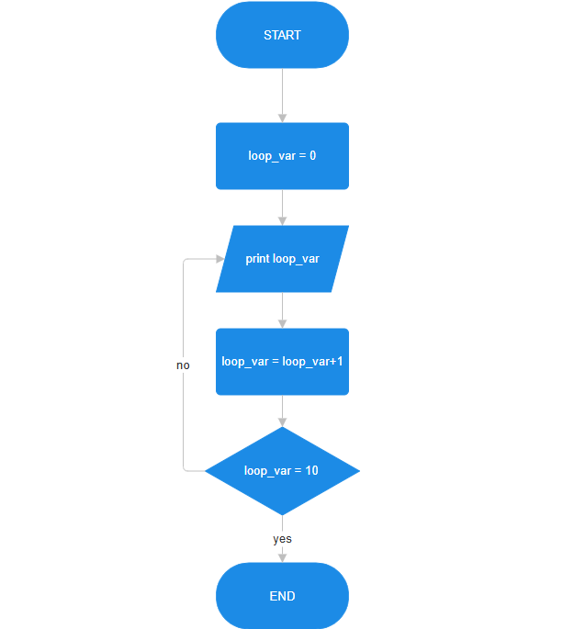
Iterations in flowcharts:

Slide 15
Activities (basic stuff)
Make IPO charts, write pseudocodes and draw flowcharts for the following:
Ask the user to input 5 numbers, then calculate the average of the 5 numbers
Ask the user for the radius of a circle. Calculate the diameter, circumference and area of the circle.
You must feed a virtual pet using cookies. Each cookie refills 25 points of hunger. Ask the user what the hunger level of the pet is. Calculate how many cookies are needed to feed the pet to full.

Slide 16
Activities (with conditions)
As a student, we love calculating our grades… Let’s help fellow students out by making a solution once and for all!
Ask the student to input their marks out of 100 for 5 subjects.
Calculate the total marks obtained and the % acquired.
Display both of the calculated things from step 2
If the % acquired is below 50%, inform the student that they failed, otherwise tell them that they passed.

Slide 17
Activities (with conditions + loops)
Draw a flowchart where you are asked to input a number, and you are told whether the number is even or odd. (Write pseudocode for it at home – share screenshots on discord)
You’re making weekly paychecks for your employees. Their normal work hours are 40 hours a week. And they get paid 10 rupees per hour (yikes). If an employee works overtime, they get 20 rupees for any hour over 40. Draw the flowchart where you are asked to input the total number of hours spent by any employee at work, based on the input calculate the amount the employee will be paid
Write a pseudocode to check whether a triangle is valid or not, when the three angles of the triangle are entered through the keyboard. A triangle is valid if the sum of all the three angles is equal to 180 degrees. Make a flowchart too.
Additional Stuff: Ask the person if they want to test the angles of another triangle. Based on yes or no, repeat the steps or say goodbye to the user.

Slide 18
Activities (with conditions)
Assume a customer is shopping at Imtiaz; The cashier sees that the customer has two types of items. The cashier will scan the items, then the quantity and price of the items will be sent to the system.
Calculate the total bill of the customer
Ask the cashier if the customer has an Imtiaz card or not
If the user has an Imtiaz Card, they get a 5% discount on the total amount, and the updated bill is displayed along with message that says “You saved ____ rupees”. Otherwise, the original bill is displayed.

Slide 19
Activities (with loops only)
Draw a flowchart/write pseudocode to calculate the average of first 10 natural numbers.
Draw a flowchart to calculate the factorial of ‘n’. ‘n’ is provided by the user. Write the pseudocode for it as well.

Slide 20
Fin~

